Slide 1

IOT BASED ACCURATE THERMAL SCREENING AND ALERT FOR COVID SITUATION USING BEAGLEBONE
Submitted By:
Rasandeep Singh
C0727753

Slide 2
Content
Introduction
INTERFACING SERVOMOTOR WITH BEAGLEBONE BLACK
Servomotor Specifications
Hardware wiring

Slide 3
Cont…
Connections
Coding
References

Slide 4
Introduction
In the project we are including the feature called servo door mechanism.
As there is a requirement to open and close the door we need to use a servomotor.
We are using a Sg90 9 g Micro Servo.

Slide 5
Cont…
We are using tiny and lightweight with high output power. Servo can rotate approximately 180 degrees (90 in each direction), and works just like the standard kinds but smaller.
We can use any hardware or library to control these servos. Good for beginners who want to make stuff move without building a motor controller with feedback & gear box, especially since it will fit in small places. It comes with a 3 horns (arms) and hardware.

Slide 6
Cont…
The wire colours are Red=Battery(+)
Brown = Battery(-)
Orange = Signal

Slide 7
Specifications
The servo motor has a Stall torque of 1.8 kgf・cm
It has an Operating speed: 0.1 s/60 degree.
It has an Operating voltage: 4.8 V (~5V)
The dead band width of the servo motor is 10 μs

Slide 8
Cont...
The servomotor has a Temperature range of 0 oC – 55 oC
Position "0" (1.5 ms pulse) is middle, "90" (~2ms pulse) is all the way to the left, ms pulse) is all the way to the right, "-90" (~1ms pulse) is all the way to the left.
The servomotor’s Dimension is 22.2 x 11.8 x 31 mm approx.

Slide 9
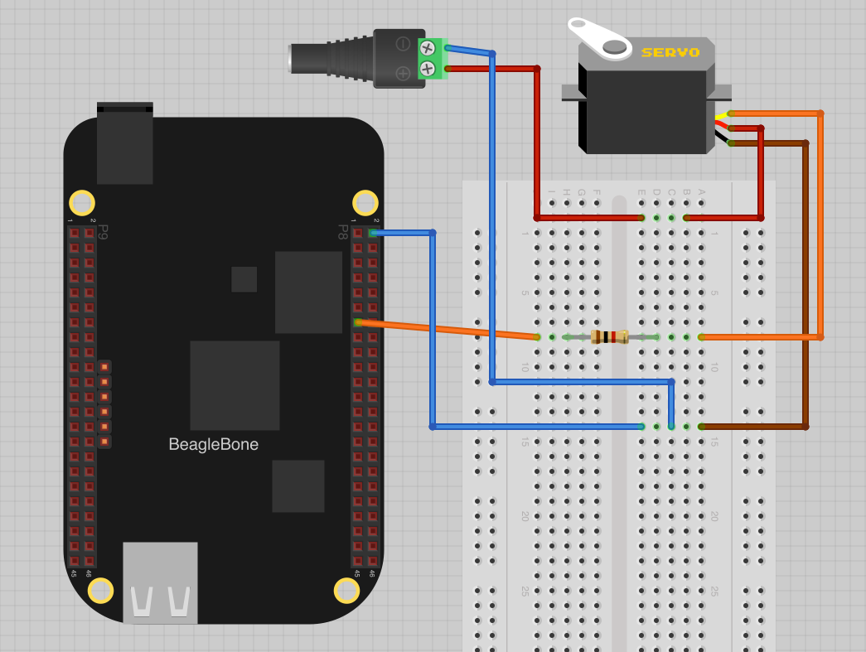
Hardware Wiring

Slide 10
Connection details
We need to use male to male jumper wires from the screw terminal to the breadboard.
Connect an external 5VDC power supply to DC power jack.
We will use pin P8_13 as the PWM output to control the servo.
The only other connection that we need from the BBB is GND.

Slide 11
Coding
#include <iobb.h> // A header library to control GPIOs of Beaglebone
#include <stdio.h> //Standard C input Output Library
#include <time.h> //Time Library
#include <unistd.h> //defines miscellaneous symbolic constants and types, and declares miscellaneous functions#include <sys/types.h> //definitions for types like size_t , ssize_t
void servo_angle(int angle); //Defining a function
int main(void)
{
iolib_init(); //Initializing the iobb library

Slide 12
Cont..
iolib_setdir(8, 12, DigitalOut); //Setting Pin direction of a specific pin of a specific port printf("Program Started\n"); // A simple print message
while(1) //Infinite Loop
{
for(int i=0;i<180;i = i+10) // A for loop to servo_angle function repeatedly with value 0 - 180
{
servo_angle(i); // Calling the Function to move servo at specific angle //iolib_delay_ms(200);
}
for(int i=180;i>0;i= i-10) // A for loop to servo_angle function repeatedly with value 180 - 0

Slide 13
Cont..
servo_angle(i); // Calling the Function to move servo at specific angle //iolib_delay_ms(200);
}
iolib_delay_ms(900); // A delay of 900 ms
servo_angle(0); // Set the Servo at 0 degree
iolib_delay_ms(900); // A delay of 900 ms
servo_angle(90); // Set the Servo at 90 degree
iolib_delay_ms(900); // A delay of 900 ms
servo_angle(180); // Set the Servo at 180 degree
iolib_delay_ms(900); // A delay of 900 ms
}

Slide 14
Cont..
iolib_free(); // Free the GPIos return(0);
}
void servo_angle(int angle) // Function for moving servo to angle
{
int delay = 0; // An integer to store delays\
delay =( (5.55 * angle)+1000); // A formula to calculate delay for Servo motor// We got the delay and other details from Servo motor (SG90) datasheet
printf("Delay %d \n",delay); // Print the calculated delay
for(int i=0;i<50;i++) // A for loop running 50 times for setting angle of Servo
{
pin_high(8,12); // Making the servo connected pin high
usleep(delay); //Delay in microseconds which we calculated above
pin_low(8,12); // Making the servo connected pin low
usleep(20000-delay); //Delay in microseconds which we calculated above subtracted by 20000
}
iolib_delay_ms(10); // Small delay

Slide 15
References
Components101. (2020, March 31). MLX90614 Non-Contact IR Temperature Sensor Pin out, Datasheet, Equivalents & Specs. https://components101.com/sensors/melexis-mlx90614-contact-less-ir-temperature-sensor
BeagleBoard.org. (2019, September 6). BeagleBoard.org - black. Retrieved June 5, 2020, from https://beagleboard.org/black
M. D. Dramićanin, Z. Antić, S. Kuzman and T. Thundat, "Contactless temperature sensing via luminescence," 2016 18th International Conference on Transparent Optical Networks (ICTON), Trento, 2016, pp. 1-1, doi: 10.1109/ICTON.2016.7550592. https://ieeexplore.ieee.o

